Slide 1

CREDIT SCORE CLASSIFICATION
Group - 3
Yamini Nathani – YXN230000
Sampath Mylavarapu- SXM220416
Naga Venkata Sai Sunil Parepalli- NXP230024
Varun Kumar Kujala – VXK230013
Saketh Kumar Dachepally- SXD230077
Venkata Sai Lakshmi Dedeepya Nekkalapudi-VXN230012

Slide 2

INTRODUCTION
Company harnessing years of credit data to automate and enhance credit score categorization through machine learning, cutting manual workload and boosting efficiency.
Leveraging machine learning, company aims to streamline credit classification, leveraging years of data to enhance accuracy and operational effectiveness.

Slide 3

DATA OVERVIEW
Data Source
Collected from Kaggle. This dataset has nearly 100,000 instances and 28 attributes, covering demographics, financials, credit specifics, and payment history.
Attributes include customer ID, age, occupation, income, credit cards, loans, payment behaviors, offering comprehensive data for credit analysis.

Slide 4

DATA WORKFLOW
•Data Description
•Data Cleaning
•Data analysis
•Machine Learning Models
•Testing
•Conclusion

Slide 5
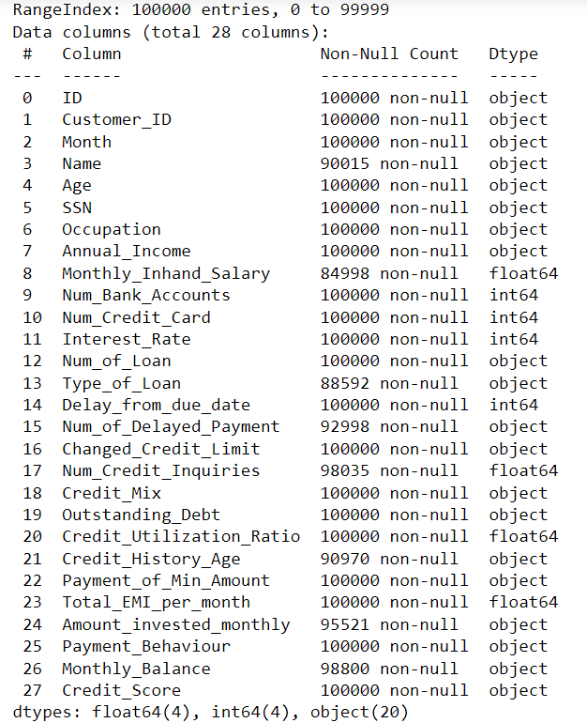
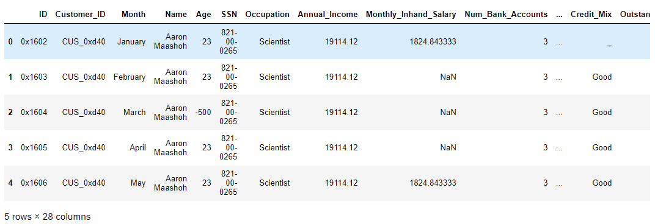
DATA DESCRIPTION

Slide 6
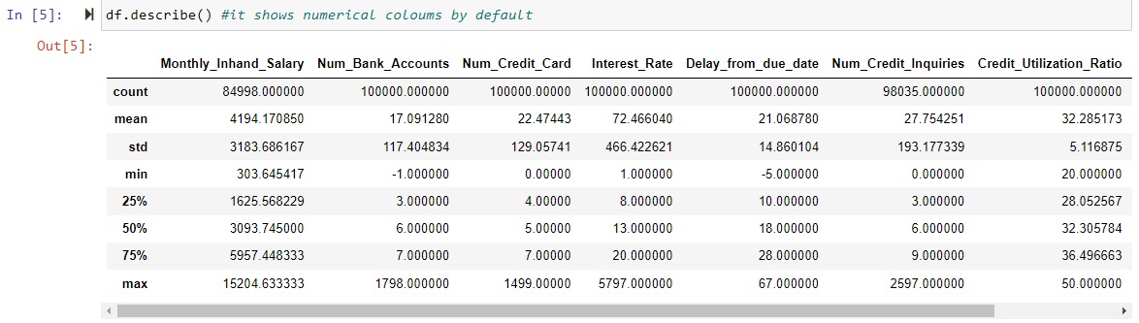

DATA CLEANING AND ANALYSIS
There are multiple missing values in the data and No Duplicates.

Slide 7
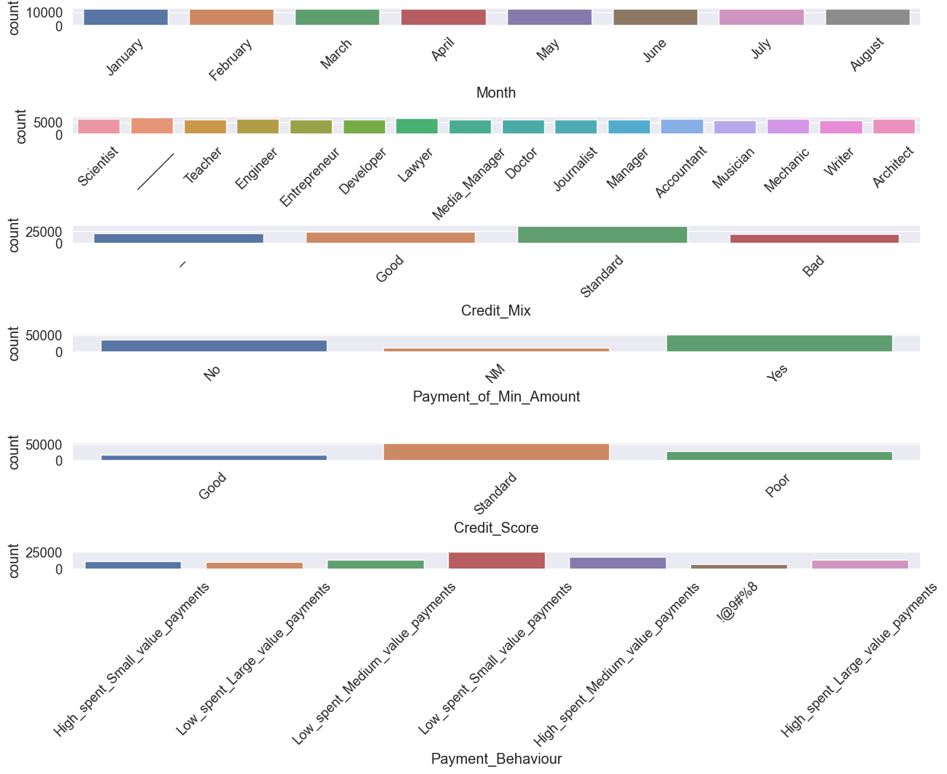
Categorical Variables

Slide 8
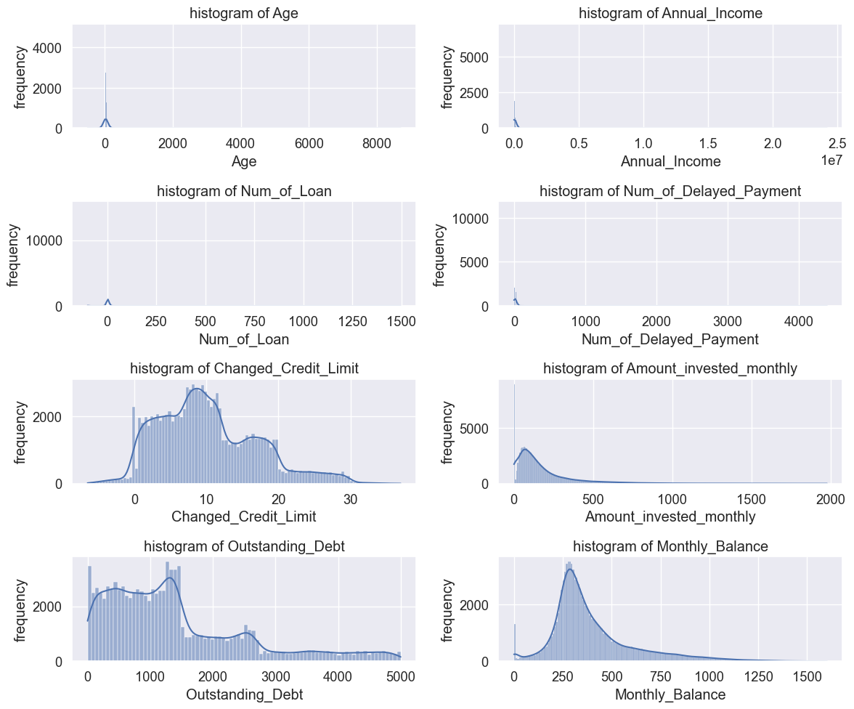
DATA PREPROCESSING
Data Preprocessing Issues:
Useless Columns:
ID, Cust_ID, SSN, Name are not useful for categorization.
Numerical Data Mislabeled as Categorical:
Age, Annual_Income, Num_of_Loan, Num_of_Delayed_Payment, Changed_Credit_Limit, Amount_invested_monthly, Outstanding_Debt, Credit_Mix, Monthly_Balance are numerical but categorized incorrectly.
Missing Entries:
Numerous missing values observed.
Occupation, CreditMix contain "__" values.
Incorrect Entries:
Num_Bank_Accounts contains negative values.
Feature Engineering:
Consider creating new features from existing ones:
Credit_History_Age
Payment_of_Min_Amount
Payment_Behaviour
Credit_Mix
Type_of_Loan
Num_Bank_Accounts
Notes:
Introduction:
Data preprocessing is a crucial step in machine learning pipelines to ensure that the data is in a suitable format for modeling.
Feature engineering involves creating new features or transforming existing ones to enhance model performance.
Data Preprocessing:
Handling Unnecessary Columns:
Identified and removed columns such as ID, Name, and SSN which are not useful for categorization.
Achieved using Pandas DataFrame's drop method.
Handling Numerical Variables:
Corrected data types for numerical variables that were mistakenly categorized as categorical.
Utilized Pandas' to_numeric method with error handling and coercion to convert categorical data to numerical.
Visualized the distribution of numerical features using histograms generated with Seaborn.
Handling Missing Data:
Utilized KNN imputation to fill missing values in numerical columns based on the closest neighbor in Customer ID.
Implemented with the help of Scikit-learn's KNNImputer.
Handling Categorical Variables:
Processed categorical variables like Occupation and Payment Behaviour.
Created dummy variables for categorical features where necessary.
Replaced erroneous values and filled missing values using SimpleImputer.
Feature Engineering:
Created New Features:
Introduced new features like Credit_History_Age, Payment_of_Min_Amount, Payment_Behaviour, etc., derived from existing data.
Implemented custom functions to parse and manipulate strings to extract relevant information.
Type_of_Loan Handling:
Created dummy columns for the 9 most frequent types of loans.
Achieved using Pandas' value_counts method and boolean indexing.

Slide 9
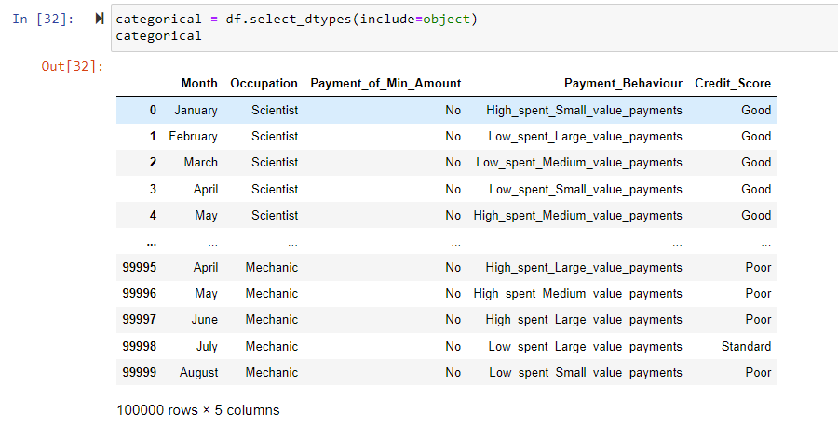
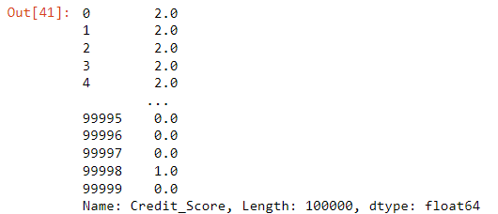
Preprocessing the Categorical Columns

Slide 10
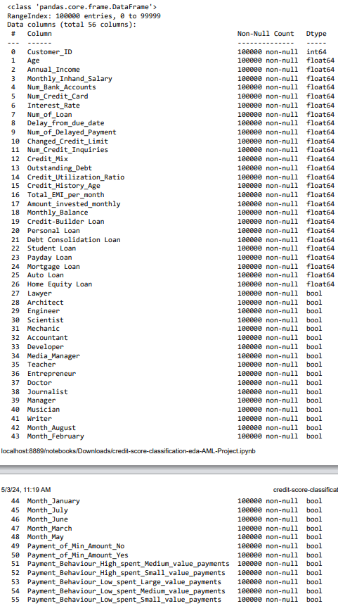
Final Data and Preparation
TEST TRAIN DATA PREPARATION:
X, y = df , df_credit_score["Credit_Score"]
scalar= PowerTransformer(method="yeo-johnson", standardize=True)
scalar.fit_transform(X)
X_train,X_test,y_train,y_test = train_test_split(X,y,test_size=0.3,random_state=42)
Notes:
Utilized PowerTransformer with the "yeo-johnson" method to transform the feature matrix (X).
Standardized the transformed data to ensure a normal distribution.

Slide 11
ML MODELS TO BE CHOSEN
Interpretability vs Accuracy - Logistic Regression Decision Tree
Feature Types: for datasets that have balanced mix of both categorical and numerical data - Catboost
Handling Non-linear relationships between variables - Xgb SVM Neural Networks

Slide 12

CONSIDERING ENSEMBLE MODELS
Ensemble Models Chosen and Why:
BaggingClassifier:
Bagging (Bootstrap Aggregating) is chosen for its ability to reduce variance and overfitting by training multiple base estimators on different subsets of the training data and aggregating their predictions.
BaggingClassifier is particularly effective when used with high-variance models like decision trees.
ExtraTreesClassifier:
ExtraTrees (Extremely Randomized Trees) is chosen for its further reduction of variance by randomly selecting feature splits at each node of the trees.
This randomness helps to decorrelate the base estimators, leading to improved generalization performance.
RandomForestClassifier:
RandomForest is chosen for its robustness and effectiveness in handling high-dimensional data with complex interactions between features.
It builds multiple decision trees and combines their predictions through averaging, resulting in a stable and accurate model.
HistGradientBoostingClassifier:
Gradient boosting is chosen for its ability to optimize arbitrary differentiable loss functions by sequentially fitting new models to the residual errors of the previous models.
HistGradientBoostingClassifier is an efficient implementation of gradient boosting that uses histogram-based techniques for improved scalability and speed.
XGBClassifier:
XGBoost (Extreme Gradient Boosting) is chosen for its state-of-the-art performance in gradient boosting, offering a highly optimized and scalable implementation.
It incorporates regularization techniques to prevent overfitting and provides support for parallel and distributed computing, making it suitable for large datasets.
By combining these diverse ensemble models, we aim to leverage their individual strengths and reduce their weaknesses, resulting in a more robust and accurate predictive model for credit score classification.

Slide 13
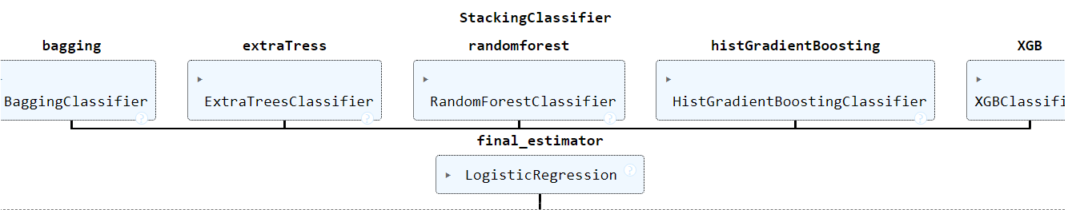
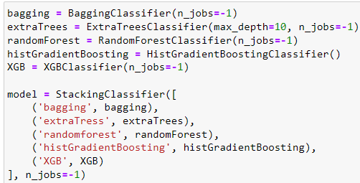
MODEL-STACKING CLASSIFIER
Stacking Classifier mixes predictions from many different models to make more accurate guesses.
It can adjust to different kinds of data and problems because it can choose different models for different situations.
Each model has its own good points, and stacking makes the most of all of them to make better predictions.
By default, Final Estimator for Stacking Classifier is Logistic regression.

Slide 14
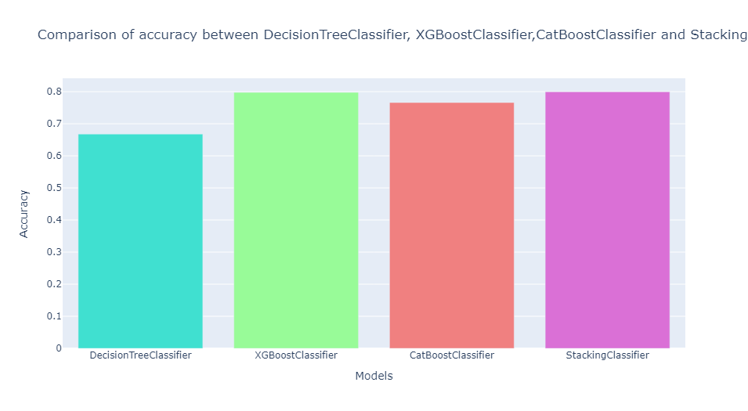
COMPARISON OF ACCURACY
DecisionTreeClassifier Accuracy :0.6678
XGBoost Classifier Accuracy :0.7976
CatBoost Classifier Accuracy :0.7660
StackingClassifier Accuracy:0.7996
The Model with the best accuracy is the "Stacking Classifier" so going ahead with it to make the classification report

Slide 15
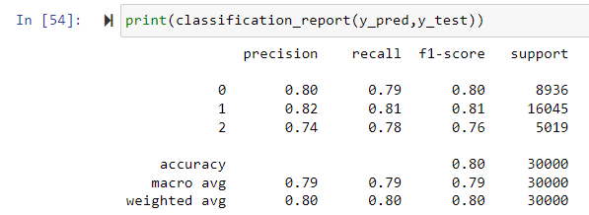
CLASSIFICATION REPORT

Slide 16
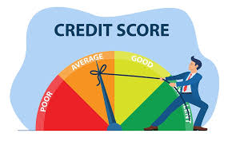
CONCLUSION
By leveraging machine learning techniques, this project seeks to provide the company with a powerful tool for classifying individuals into credit score brackets.
The model developed through this project can help the company make more informed decisions and improve its credit assessment processes, leading to greater efficiency and effectiveness.

Slide 17


THANK YOU

